Slide 1
Numerical Analysis
Module Introduction
Russell Kabir, PhD

Slide 2

Contents
Introduction
Seminar Sessions
Module Content
Assessments
R
Datasets
n Questions and Answers

Slide 3
Introduction of Tutor and Students
Session to be recorded
Please turn on microphone to talk or type in the chat box.
If not talking, please keep microphone on mute.
There will be opportunity for questions at the end too.

Slide 4
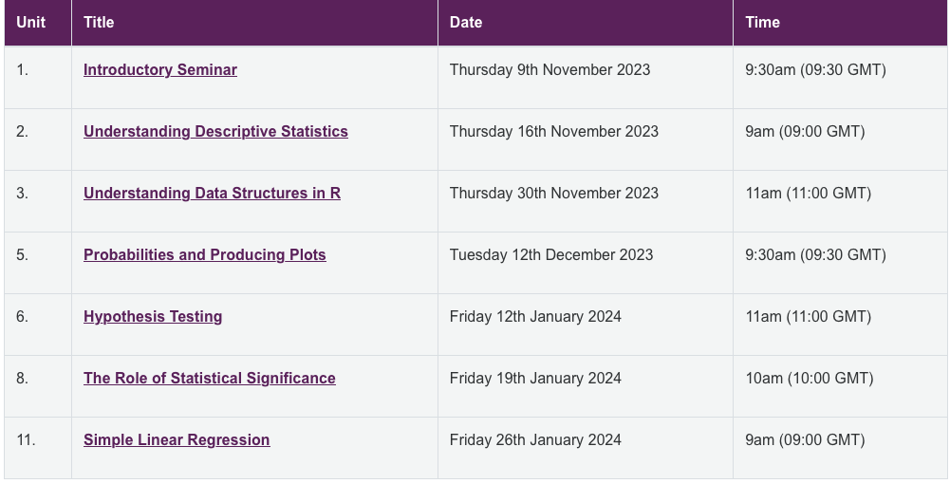
Seminar Sessions

Slide 5
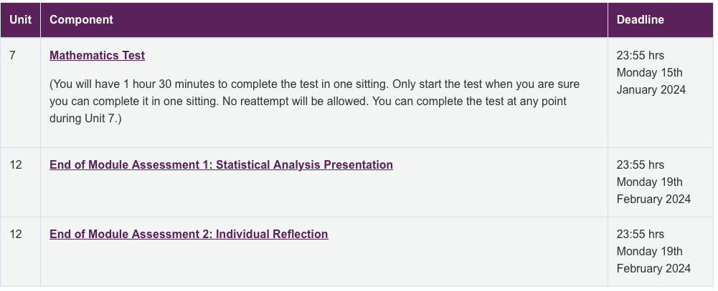
Assessments
Assessment 1 : Test

Slide 6
Mathematics Test Information
Opens: Tuesday, 9 January 2024, 12:00 AM
Closes: Monday, 15 January 2024, 11:55 PM
You will have 1 hour 30 minutes to complete the test in one sitting. Only start the test when you are sure you can complete it in one sitting.
No reattempt will be allowed. You can complete the test at any point during Unit 7.

Slide 7
Statistical Analysis Presentation and Reflective Account
Statistical Analysis Presentation: Due date 19 February 2024
Individual Reflection: Due date 19 February 2024

Slide 8
Additional Activities
Unit 2 Data Activity
Unit 3 Data Activity
Unit 4 Probability Activities
Unit 5 Collaborative Discussion 1
Unit 8 Data Activity
Unit 9 Collaborative Discussion 2
Unit 10 Data Activity
Unit 12 Bayes Activity

Slide 9
Computer Analytical Software Packages
SPSS: Statistical Package for Social Scientists (Version 29 for Windows)
JASP
JAMOVI
R
Python
STATA
MS Excel
Minitab
SAS

Slide 10
R and RStudio
R
RStudio
Programming language
For data analysis and graphics
Refers to both the language and the software that interprets it’s scripts
Free and open source
User interface for working with R
Wrapper around the R language
Extends what R can do and facilitates writing R code
Free and open source

Slide 11
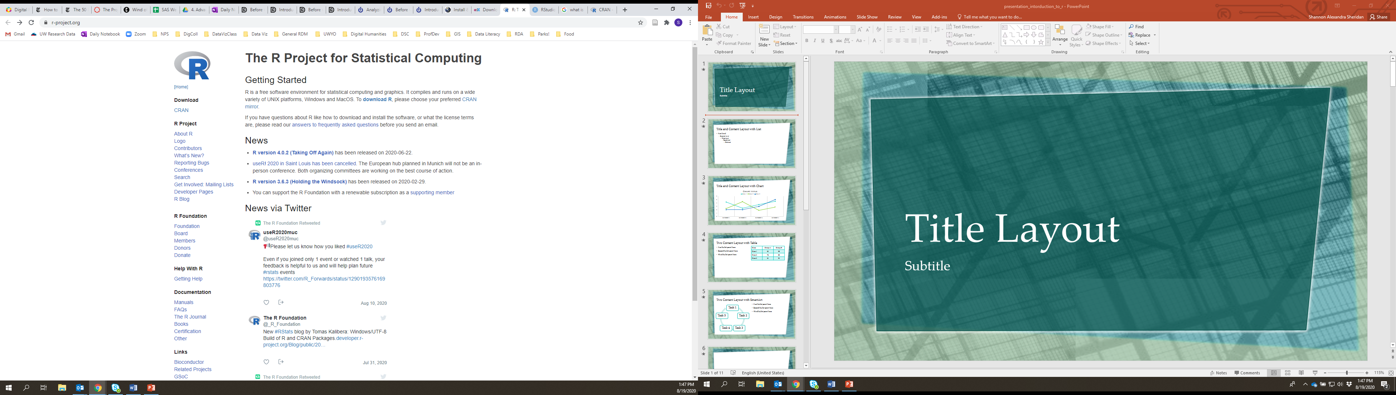
Downloading R Studio

Slide 12
Questions and Answers

